Slide 1
Workflow Recovery System
Eastern Eagles Team:
Mateusz Gołąb
Csaba Kerti
Jakub Kiełbasa
Zsolt Kollarits
Notes:
Sept 2010

Slide 2
Presentation Plan
Team Management [short Kuba]
Goals and Objectives [short Kuba]
Design Applied [Mat]
Testing Strategy [Csaba]
Prototype Demonstration [Zsolt]
Costs Identification [short Zsolt]
Summary and Discussion [all]
Notes:
Sept 2010

Slide 3
Team Management
Notes:
Sept 2010

Slide 4
Team Management
Notes:
Sept 2010

Slide 5
Team Management
Notes:
Sept 2010

Slide 6
Team Management
Notes:
Sept 2010

Slide 7
Goals of the Project
Notes:
Sept 2010

Slide 8
Goals of the Project
Notes:
Sept 2010

Slide 9
Goals of the Project
Notes:
Sept 2010

Slide 10
Design of the Project
Notes:
Sept 2010

Slide 11
Design of the Project
Notes:
Sept 2010

Slide 12
Design of the Project
Notes:
Sept 2010

Slide 13
Design of the Project
Notes:
Sept 2010

Slide 14
Design of the Project
Notes:
Sept 2010

Slide 15
Testing Strategy
Requirement Test
Start early
Functional requirement test
be clear
be consistent
clarify assumptions
discover missing requirements
Non-functional requirement s
concrete values
Notes:
It is very important to find faults and misunderstandings at the early stage of a software development project as soon as possible.
Many projects fail because of the misinterpreted requirements. => Very important to clarify the requirements with the customer.
It should be clear for a designer or a programmer, who read it at the first time, and doesn’t know the aims of the project.
We had many assumptions at the beginning of the project, and we tried to discover them day by day. We contacted with the customer and clarified these assumptions.
We read and reviewed the given document many times to clarify missing and hidden requirements.
Non-functional requirements:
- number of parallel users
- supported operating systems
Testing:
Compatibility testing (network, operating system)
Performance testing
Security testing
Sept 2010

Slide 16
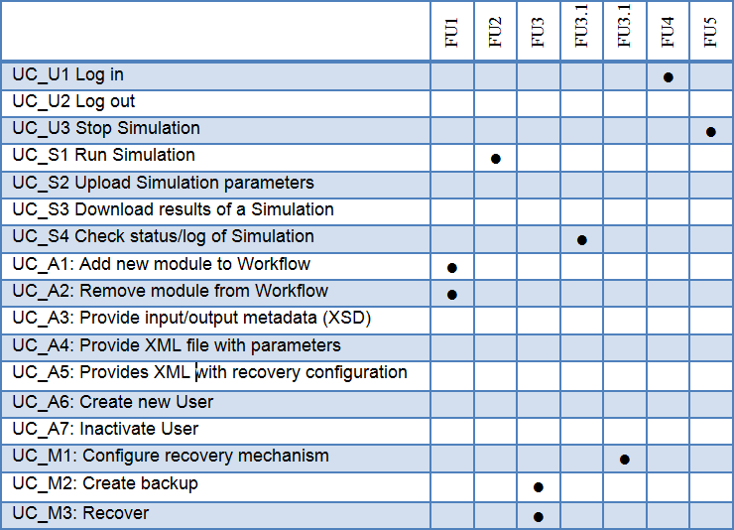
Testing Strategy
Preparing Acceptance Test
Trace-ability Matrix for use-cases
Notes:
The acceptance test should be executed at the end of the project, but it is recommended to start the preparations at the beginning.
After we had produced the requirements we have created the use-cases using the UML.
The Trace-ability Matrix is a good practice to check that is all the functional requirements are covered by use-cases.
The Trace-ability Matrix is very usual tool to follow the requirements changes. By using them, it is easy to see which use-case should be changed.
Sept 2010

Slide 17
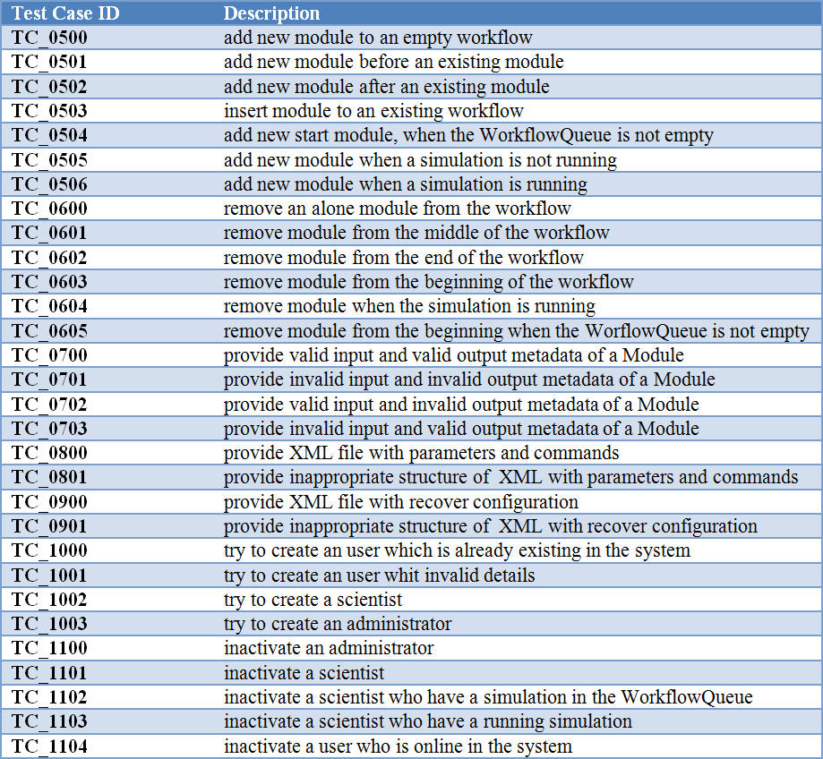
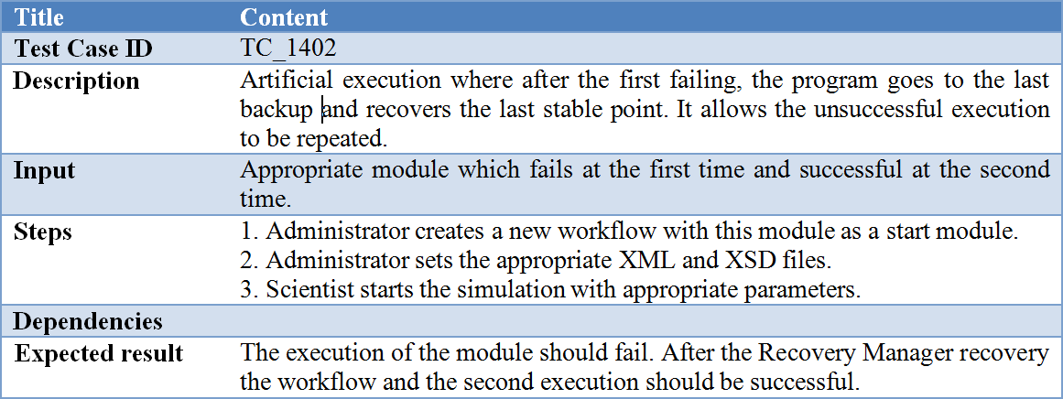
Testing Strategy
Test Cases
Notes:
We created test cases to test the correctness of each operation and to examine how they affect each other.
We made many test case variants for each operation to reach better test coverage.
We chose the following form to describe each test case.
Sept 2010

Slide 18
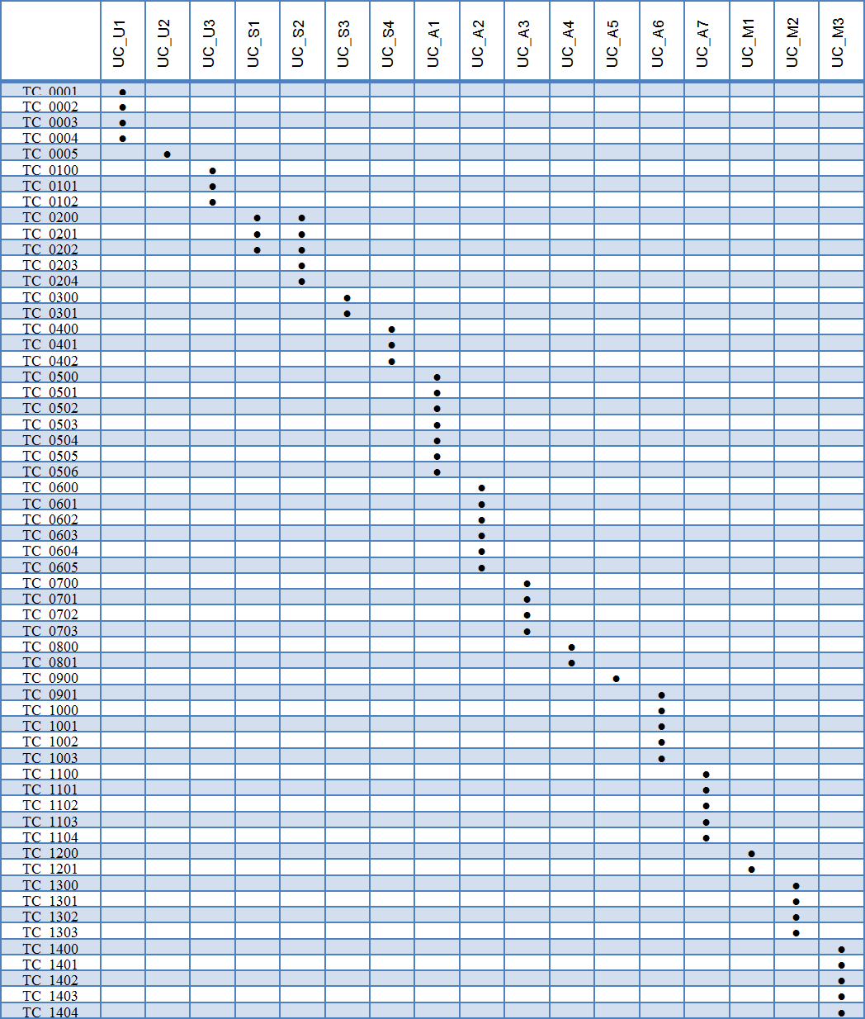
Testing Strategy
Trace-ability Matrix for test-cases
Notes:
The Trace-ability Matrix is also usable to check that at least one test-case exists for every use-cases.
The columns contain the use-cases, while the rows contain the test-cases. When a test-case connects with a use-case, we sign it with a dot.
Sept 2010

Slide 19
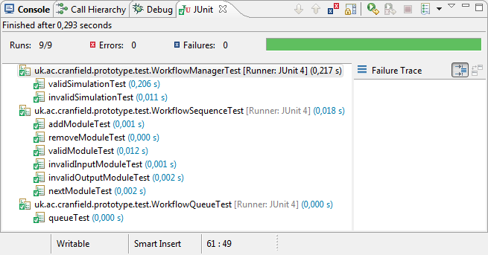
Testing Strategy
Unit test
Integration test
Unit test
Junit
Integration test
JUnit
Mocks
Scenarios
Notes:
We choose the Java programing language for the implementing our system. JUnit is an easy to use environment for Java, to create repeatable tests.
So it was convenient to choose the JUnit as a testing environment. We planned to create JUnit testes for every unit and component.
Integration test
JUnit is not limited for unit tests, so we decided to use JUnit where it is a possible in the system.
Many mock classes have been created to ensure the excitability of the prototype. Furthermore these mock classes are very important to execute the unit testes.
We plan to test the bigger components of the application, and examine how they work together.
The modules which we plan to test in the integration test:
WorkflowManager / RecoveryManager / WorkflowSequence
A few scenarios what we plan to examine:
The Workflow gets knowledge about the unsuccessful execution. It asks the RecoveryManager to get the last stable point, who forwards it to Database Manager. Finally the WorkflowManager should get the last backup from the DatabaseManager through the RecoveryManager.
After a successfully execution, if the RecoveryManager decide to store the result it sends it to the DatabaseManager and the backup will be store in the database.
Sept 2010

Slide 20
Implementation
Notes:
Sept 2010

Slide 21
Implementation
Notes:
Sept 2010

Slide 22
Implementation
Notes:
Sept 2010

Slide 23
Demonstration
Notes:
Sept 2010

Slide 24
Costs
Notes:
Sept 2010

Slide 25
Costs
Notes:
Sept 2010

Slide 26
Costs
Notes:
Sept 2010

Slide 27
Summary
Notes:
Sept 2010

Slide 28
Question?
Notes:
Sept 2010

